Slide 1
Introductory General Chemistry
Chemistry 3A
S. M. Halloran

Slide 2
Lewis Structures: The Octet Rule
Showing Lewis Structures in Covalent Molecules
The Shapes of Molecules
Electronegativity & Polarity
Interacting Forces Between Molecules: Dispersion, Dipole-Dipole, Hydrogen Bonding

Slide 3
Review of Periodic Table Patterns
The periods of the Periodic Table show a pattern of 2 elements in 1st period, then 8 elements in the 2nd and 3rd periods. (The 4th & 5th have 18 each, then the 6th & 7th have 32 each)
But it’s the elements of the 2nd & 3rd periods, particularly the 2nd, that strongly interest us.
On the left side of PT, the metal elements want to lose electrons to become POSITIVELY ionized (as cations). They have only 1, 2, maybe 3 electrons in their valence (outermost) shell that they give up in a true ionization of the atom.

Slide 4
Review of Periodic Table Patterns
The electrons given up readily by the metal elements in the Groups 1 and 2 are taken by the Group 16 and 17 non-metal elements on the other (right) side of the Table, which want those electrons to become negatively charged ions (anions)
This is all about stability, achieving the lowest energy state. It is about atoms ordering electrons in their orbits in an effort to become like the noble gas Group 18 elements

Slide 5
Review of Periodic Table Patterns
For Period 2 elements
Li and Be will lose 1 and 2 electrons, respectively, to become Li⁺ and Be²+, adopting a closed shell configuration looking like He, with its “duet” (2-electron) valence shell
On right side of table, F and O will acquire 1 or 2 electrons, respectively, to become F⁻ and O²⁻, adopting a closed shell configuration looking like Ne, with its “octet” (8-electron) valence shell
For Period 3 elements
Na and Mg will lose 1 and 2 electrons, respectively, to become Na⁺ and Mg²+, adopting a closed shell configuration looking like Ne, and “octet” valence shell
On right side of table, Cl and S will acquire 1 or 2 electrons, respectively, to become Cl⁻ and S²⁻, adopting a closed shell configuration looking like Ar, with its “octet” valence shell

Slide 6
The Octet Rule (Ions)
The octet name refers to particularly to atoms wanting to have a valence shell of 8 electrons that makes them look like the closest noble gas element
For elements on the left side of table, they will lose electrons to be like the noble gas element of the previous period. They will become positively ionized (1+, 2+, …) in the process
For elements on the right side of table, they will gain electrons to be like the noble gas element of the current period. They will become negatively ionized (1-, 2-, …) in the process
This is the case for metals and non-metals which will form ions and become ionic compounds

Slide 7
The Octet Rule (Molecules)
But when non-metal atoms form bonds with each other, they do NOT gain or lose electrons in the way metal and non-metal atoms do in ionization
Instead, the non-metal atoms will create a valence shell of 8 electrons around them, but these 8 electrons are shared between the atoms

Slide 8
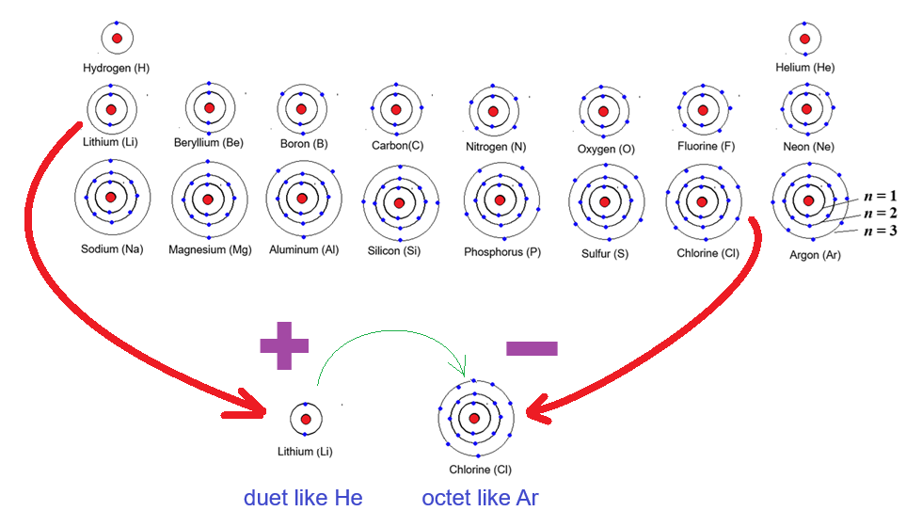
Wanting To Be Like Noble Gas Elements
Forming the octet (or duet) by ionization, to be an ionic compound

Slide 9
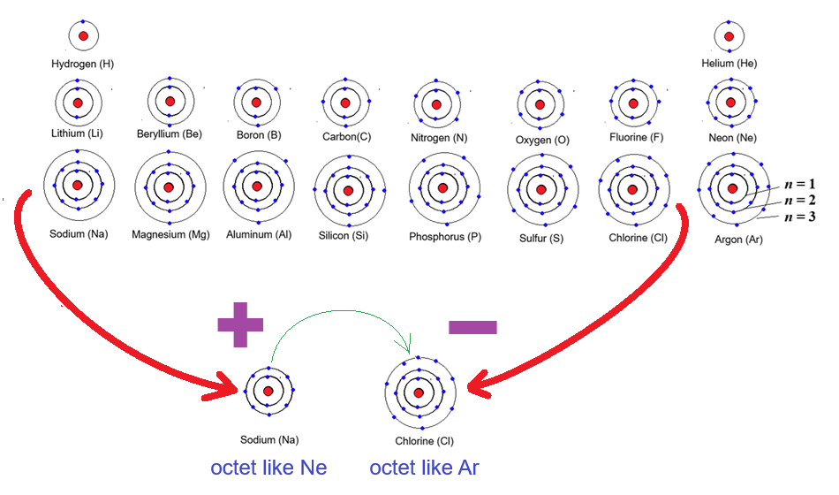
Wanting To Be Like Noble Gas Elements
Forming the octet by ionization, to be an ionic compound

Slide 10
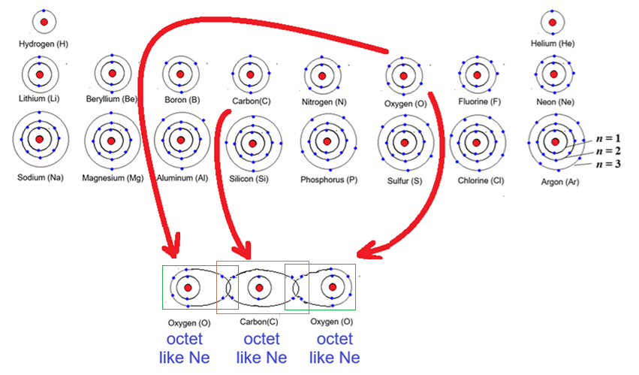
Wanting To Be Like Noble Gas Elements
Forming the octet through covalent bonding, or sharing.
The boxes count 8 electrons in valence (outermost) shells
Count them!

Slide 11
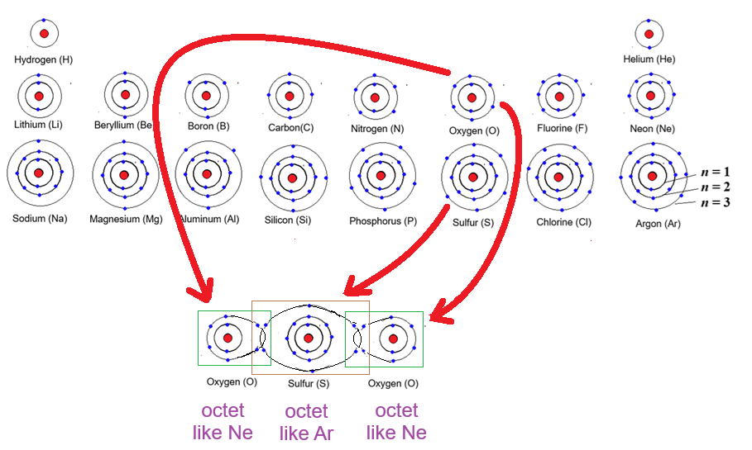
Wanting To Be Like Noble Gas Elements
Forming the octet through covalent bonding, or sharing.
The boxes count 8 electrons in valence (outermost) shells
Count them!

Slide 12










Electron Dot Diagramming
Lewis structures are the presentation of atoms with their valence (outermost shell of) electrons represented as dots
The dots can be placed around the element symbol top, right, bottom, left
The purpose of these diagrams are as an aid to chemists in showing the electrons available for BONDING of atoms to each other

Slide 13
Formation of Ionic Compounds
Sodium (Na) in Group 1 has 1 valence (outermost shell) electron. Getting rid of it will make it have the octet of the noble gas element of the previous period, neon (Ne). This provides an energy stability to sodium. It will become a +1 positive ion, so will be attracted to -1 negative ions.
Chlorine (Cl) in Group 17 has 7 valence electrons. If it just adds one more electron to that valence shell, it will have the octet of the noble gas element of its period, argon (Ar), providing energy stability to chlorine. It will become a -1 negative ion, so will be attracted to +1 positive ions
Sodium and chlorine thus form ionic compounds with each other
Ionic compounds are formed by bonds that are based on positive and negative electric charge points

Slide 14
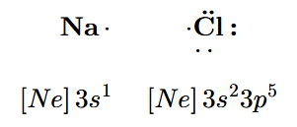

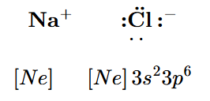
Lewis Structures of Ionic Compounds
Initially the Lewis structures show the atoms with their natural number of valence electrons, having zero charge
For sodium (Na), there is 1 valence electron (dot). For chlorine (Cl), there are 7 electrons (dots)
Note the electron configurations: Na⁰ has its valence shell at n = 3. Cl⁰ in same period has its valence shell at n = 3 too. (the n value is just a coincidence)
An electron moves from Na to Cl → Na⁺ and Cl⁻ form
Na⁺ has electron configuration of Ne now. [Ne] is also [He]2s²2p⁶, and Cl⁻ has configuration of [Ar], which is actually [Ne]3s²3p^{6.}

Slide 15
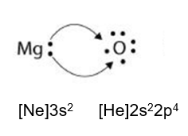
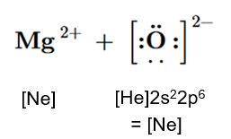
Two Electrons Moved
Group 2 element magnesium (Mg) has two electrons in its valence shell. Note the Lewis structure and the electron configuration of Mg⁰
Group 16 element oxygen (O) has six electrons in its valence shell. See its Lewis structure and electron configuration of O⁰
Mg willingly gives its two electrons, which O willingly takes
The Mg²⁺ ion now has the octet structure of the previous period noble gas, and O²⁻ has the structure of the noble gas element of its period

Slide 16
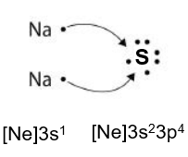
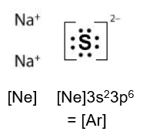
Two Electrons Moved, But FROM Two Atoms
Sulfur, in same Group 16 as oxygen, but one period down, is ready to take two electrons into its valence shell with 6 electrons, to complete the octet
It is not required that it be from a Group 2 element with two electrons. Instead it can be two Group 1 elements, like potassium (K) or lithium (Li), but in this case sodium (Na) again
Note the resulting electron configurations and Lewis structures

Slide 17
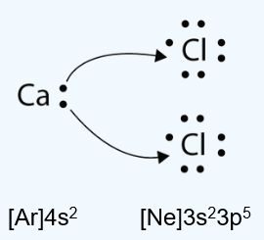
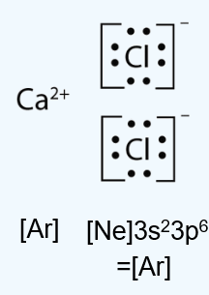
Two Electrons Moved, But TO Two Atoms
This diagramming just demonstrates how the two valence shell electrons of calcium (Ca) in Ca⁰ where one each is used to add one electron to each of two chlorine (Cl) atoms in the Cl⁰ state
The result is a Ca²⁺ ion, two Cl⁻ ions, and these will be the formula unit of ionic compound solid/crystal that is the compound
Note how the electron configurations of the ions in the compound show how they form the octet of a noble gas element

Slide 18
Summarizing Ionic Compound Lewis Structures
Lewis structures are dot diagrams of atoms where the dots around the atom represent the valence (outermost) shell of electrons
Electrons are involved in bonding. Bonding of the ionic type is where one atom fully takes the electron(s) of another atom, and the resulting electric (positive and negative) charges are what creates the bond (attraction), a strong force keeping the atoms close to each other
Start with a Lewis structure of the neutral (zero-charge, non-ionized) atom with its proper number of electrons; then move the dots (electrons) as they interact with other atoms

Slide 19
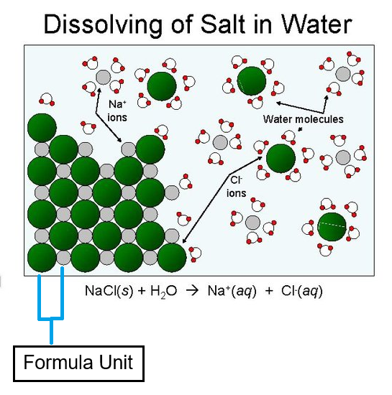
More Detail on Formula Unit
The formula unit describes an ionic compound (salt) in the solid phase
It is the smallest, electrically neutral ratio of ions in a 3-dimensional crystal lattice
Unlike a molecule, it is NOT a distinct independent particle
The formula unit does NOT describe solvated ions (ions in the aqueous phase)

Slide 20
Lewis Structures of Covalent Compounds
Ionic compounds represent one end of a spectrum of chemical bonding
Covalent compounds—where atoms bond by the sharing of electron pairs—electron pairs make up bonds—represent another end of that chemical bonding spectrum
It must be re-emphasized that these covalent compounds will typically point to the bonds between nonmetal elements
Determination of Lewis structures will follow a specific set of rules to be detailed on slides that follow

Slide 21
Lewis Structures of Covalent Compounds
Determine total number of valence shell electrons in the molecule/ion
Add the electrons from each atom
OF₂: 6 e⁻ from O atom, 7 e⁻ from F 6 + 2 × 7 = 20 e⁻
If species is polyatomic ION, be sure to add or subtract electrons that give the ion its charge
CO₃²⁻: 4 e⁻ from C atom, 6 e⁻ from O, 2 e⁻ from charge 4 + 3 × 6 + 2 = 24 e⁻

Slide 22
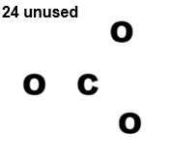
Lewis Structures of Covalent Compounds
Arrange atoms to show their specific bonding
There is usually one atom in a polyatomic compound that is a central atom, or the atom to which other atoms are bonded to
For example, in CO₃²⁻ or CCl₄, this will be the carbon (C) atom
For an atom like hydrogen (H), it would never be a central atom (instead it is a terminal atom, at the terminus of a bonding series)

Slide 23
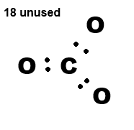
Lewis Structures of Covalent Compounds
Put a bonding pair of electrons between all the atoms
A single bond between atoms uses two electrons (orbital pair)
For atoms in a molecule/polyatomic ion to be connected or bonded to each other, there must be at minimum a single bond between them

Slide 24
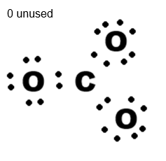
Lewis Structures of Covalent Compounds
For the terminal atoms (like oxygen, O), use the remaining electrons to create a total of 8 electrons (the octet) surrounding the atom
Arrange the electrons so they have a paired look!
Note the nonbonded LONE PAIRS in the atoms!
Do not put an octet for hydrogen (H): it only has
a duet for its valence shell

Slide 25
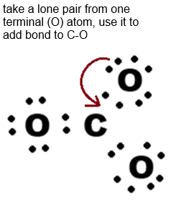
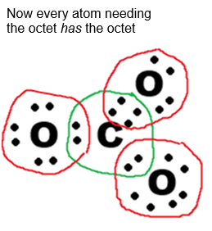
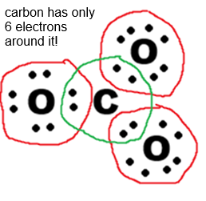
Lewis Structures of Covalent Compounds
Leftover electrons are placed on the central atom
Now check the central atom: does it have an octet of electrons around it? If NOT, then move lone pairs from other atoms to form double- and triple-bonds between central and terminal atoms to make an octet

Slide 26
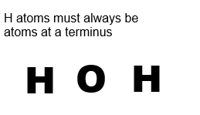
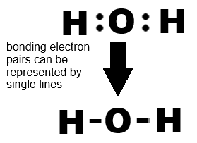
Let’s Do It Again: Water
# valence electrons = 2 H x 1 e⁻/H + 1 O x 6 e⁻/O = 8 e⁻
Arrange the atoms for central and terminus:
Now put at least one bonding pair between the atoms
Electrons used were 4; still have 4 left

Slide 27
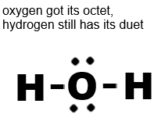
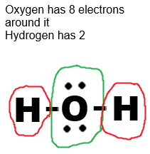
Let’s Do It Again: Water
# valence electrons = 2 H x 1 e⁻/H + 1 O x 6 e⁻/O = 8 e⁻
Arrange the atoms for central and terminus:
Now put at least one bonding pair between the atoms
Electrons used were 4; still have 4 left

Slide 28
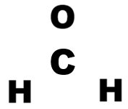
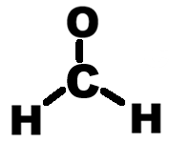
One more time: Formaldehyde (CH₂O)
# valence electrons = 2 H x 1 e⁻/H + 1 O x 6 e⁻/O + 1 C x 4e⁻/C = 12 e⁻
Arrange the atoms for central and terminus:

Slide 29
Resonance

Slide 30
Octet Rule Exceptions

Slide 31
Molecular Shape Prediction

Slide 32
Electronegativity

Slide 33
Polarity

Slide 34
Intermolecular Forces
Dispersion
Dipole-Dipole
Hydrogen Bonding

